Slide 1
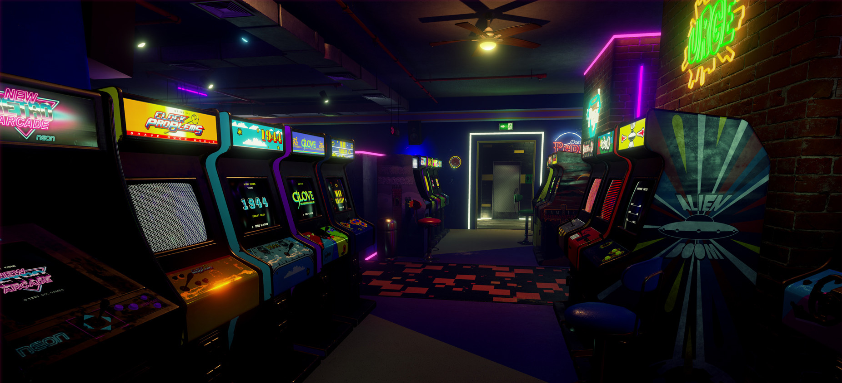
Arcade Games
Miffy Chen
CS 622 Adv. Java
Notes:
Started with an ambitious plan to implement a retro-styled arcade with various games to choose from.
Narrowed down to 2.

Slide 2
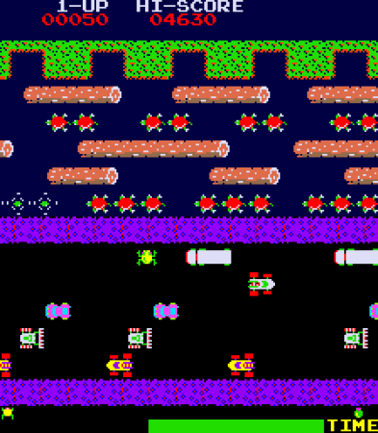
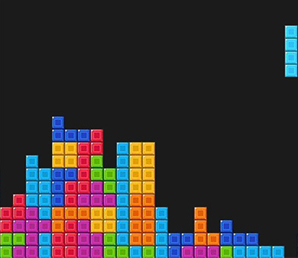
Games
Tetris (Java Swing)
Frogger (JavaFX)
Notes:
Tetris with Swing.
Frogger with JavaFX.
Breeze through Tetris, most know how to play & rules.
Might not be familiar with Frogger. More complex implementation.

Slide 3
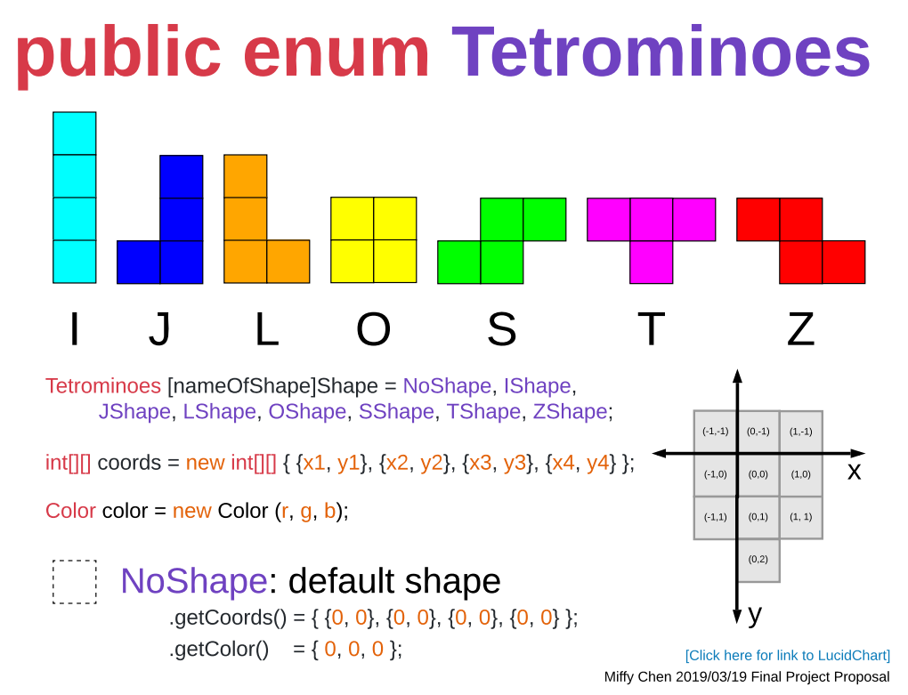
Notes:
Tetrominoes: possible shapes made up of 4 blocks of squares.
Made into enum for easy access.
Very good practice in drawing shapes, becoming familiar with x/y coordinates on canvas.
See some examples.

Slide 4
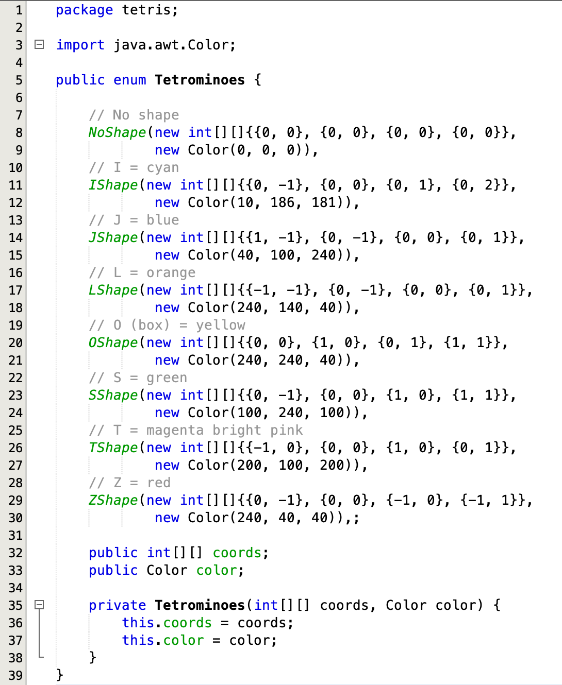
Notes:
This is what the code looks like.
Just to try out a few shapes: I, J, O, S.

Slide 5
Notes:
J

Slide 6
Notes:
O (Box)

Slide 7
Notes:
S

Slide 8
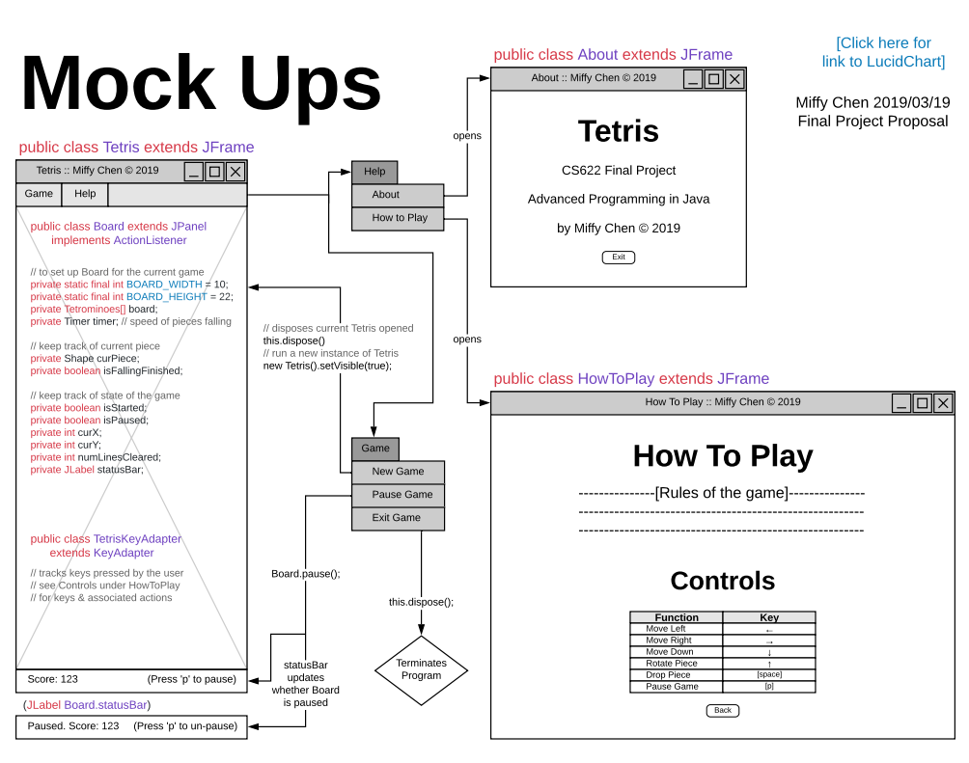
Notes:
JFrames: About, HowToPlay, Tetris (Main/Driver class).
MenuBar, fulfill one of the requirements to have different panes/tabs.
Good practice with drag and drop.
Board is a class extends JPanel, where the action will be drawn, using it to listen for keys pressed.
JLable, attached to SOUTH of the Board using Layout.

Slide 9
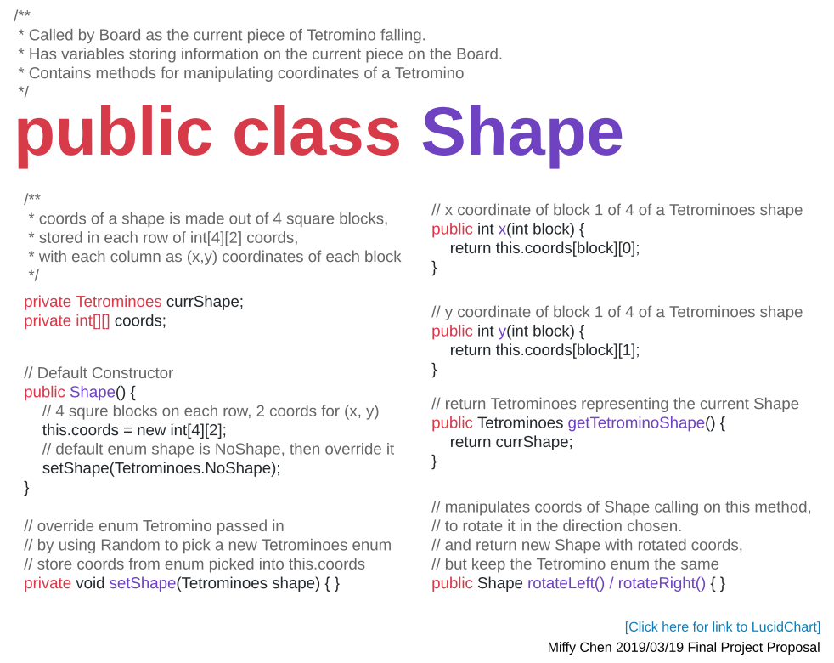
Notes:
Shape class that will be drawn to the Board.

Slide 10
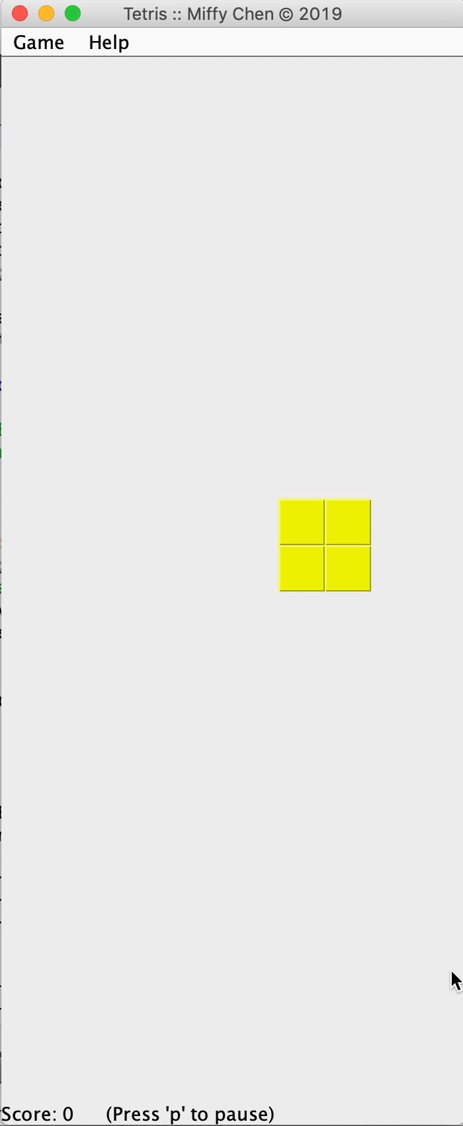
DEMO!!
Notes:
Demo game.
Show a bit of code.

Slide 11

1981 Konami version
Objective: cross the roads/pond to his home
Scoring:
Each forward step taken += 10
Get home += 60
If dies -= 50 (only if score is >= 50)
Obstacles:
Purple = safe space (@ 50 point mark)
Turtle sinks down == death
Edge of screen: Logs / Turtles, pushes back
https://youtu.be/WNrz9_Fe-Us?t=80
Notes:
Found a lot of the image files
So if you take 2 steps, and dies while having a score of 20, you won’t be deducted points.

Slide 12
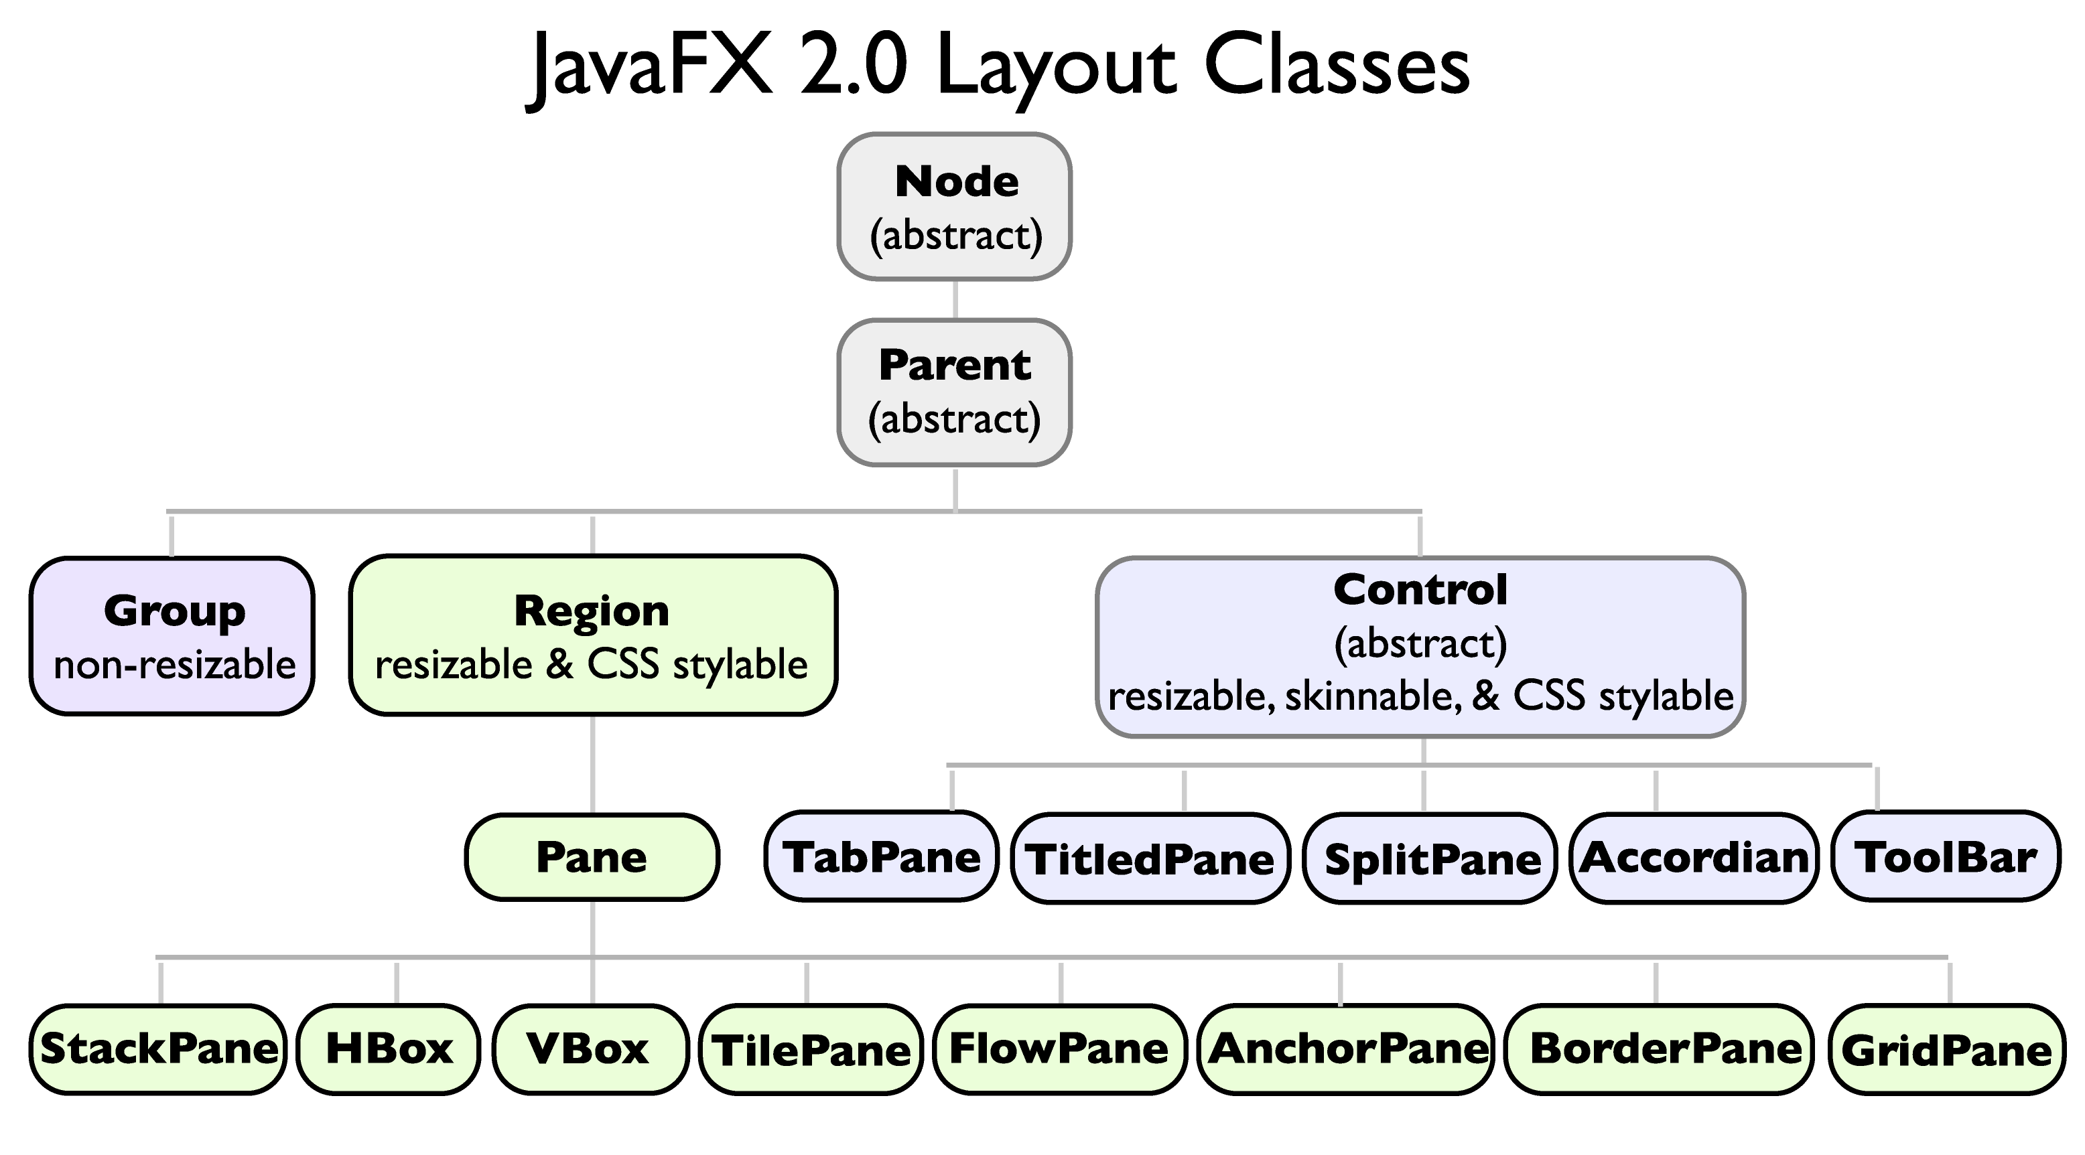
Notes:
So onto Frogger!
I found this image that really explains the architecture or hierarchy of JavaFX in a very clear way.
So I’m going to switch back on forth between how I organized my application by referring to this chart.

Slide 13
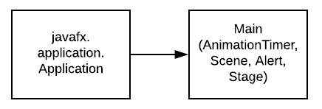
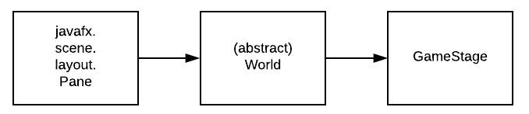
Main extends Application
AnimationTimer
new Scene (GameStage, xSize, ySize)
GameStage.add(Actor/Image);
GameStage.playMusic() / .stopMusic();
abstract World extends Pane
World.add(Actor[extends ImageView])
World.add(Image)
World.start(): timer
World.stop(): timer
abstract void act (long now)
Notes:
For each second passed, checks whether score has changed, if so, then update.
Every GameStage object will have an act(timer) that they override.
Main declares and initializes the Actors that will be added to the GameStage.
Show code for Main.

Slide 14
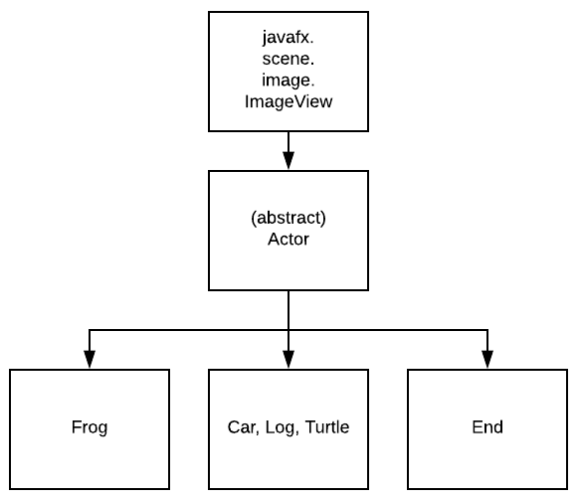
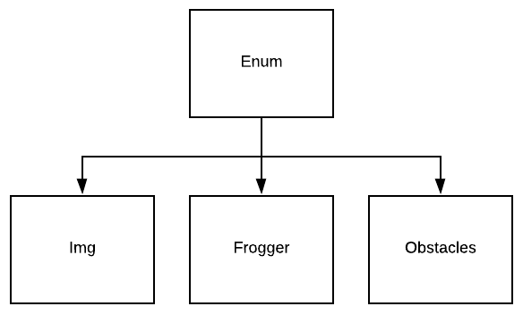
Actors utilize Enums:
Data of each Image
Get x/y coordinates
Returns Image / ImageView
Actor extends ImageView
added to GameStage
Notes:
Also used Enum structure just like the Tetris game, found very efficient. - Img for background pictures, score pictures
- Frogger with frog facing different directions, jumping animation, death animation
Frog is the frog controlled by players. ControlListeners and ScoreData kept here.
Car, Log, Turtle are all obstacles for the Frog when crossing to the End.

Slide 15
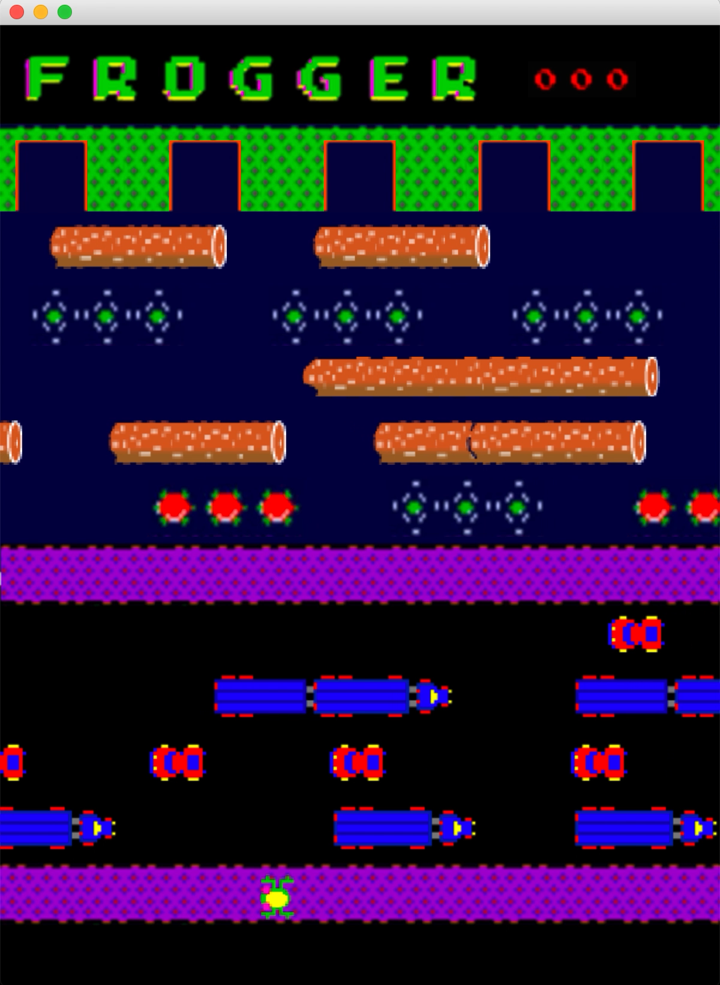
DEMO!!
Notes:
Demo game.
Show a bit of code.

Slide 16
Future Improvements
Tetris
Frogger
High Scores
“Hold” Queue
“Next” Preview
Timer Display
High Scores
Lives Limit
Time Limit

Slide 17
Thank You!!

